Slide 1
Managing MySQL database
Setting up & Managing MySQL Databases on MyWeb
0360-270-91 Advanced web design
Abedalrhman Alkhateeb

Slide 2
Database
A database is a data structure that stores organized information.
This course will not cover database in details.
will use MySql database to store data for the website.
it is not an exam material.
but we need to use it as black box to store data for the final project.
Table is a structure in the DB to store the data in row/column format, where the columns are the fields, the rows are the data (the records).

Slide 3
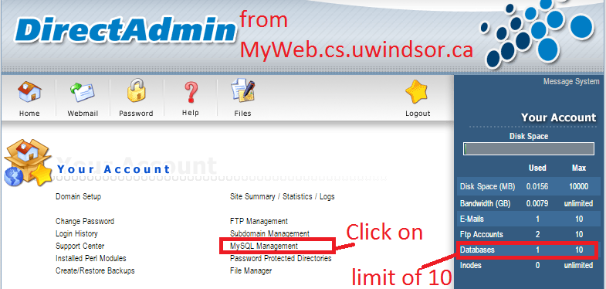
Accessing MySQL

Slide 4
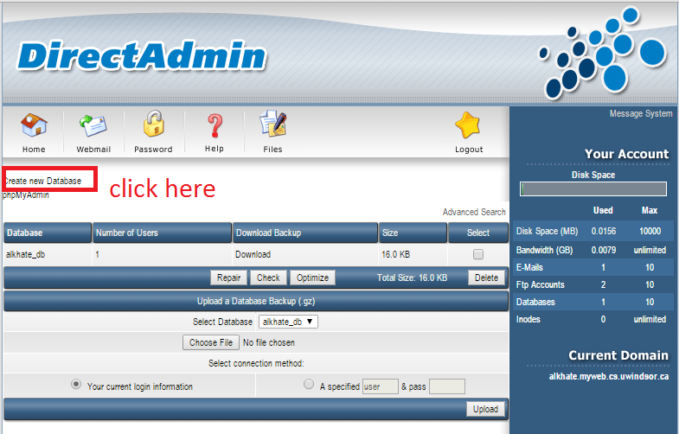
Creating Database

Slide 5
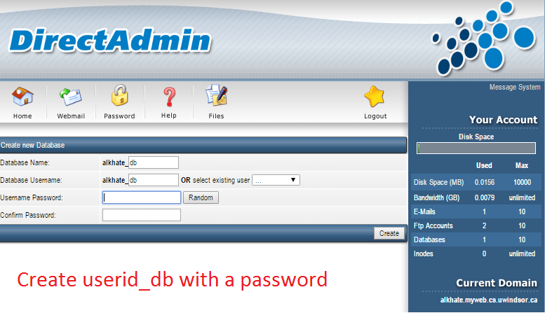

Slide 6
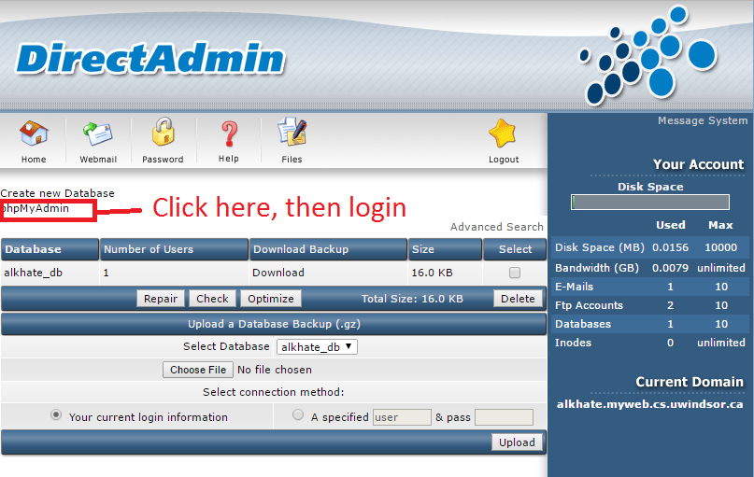
MySQL Administration

Slide 7
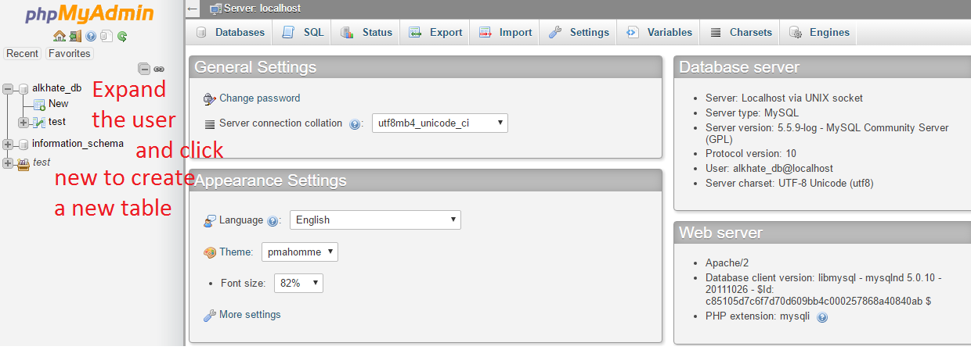
Create a Table

Slide 8
Profiles Table
We are going to create a table named profiles to store the user/clients information.
You may create users/clients/customers/profiles table in your final project.
The table will have the following fields.
id as integer number , it is a primary key , it means that it has a unique and a mandatory( NOT NULL) value.
Fname, and lname fields has the type varchar with length of 30.
DOB to store the date of birth, date type
Created_date the creation time-stamp, default the creating timestamp.

Slide 9
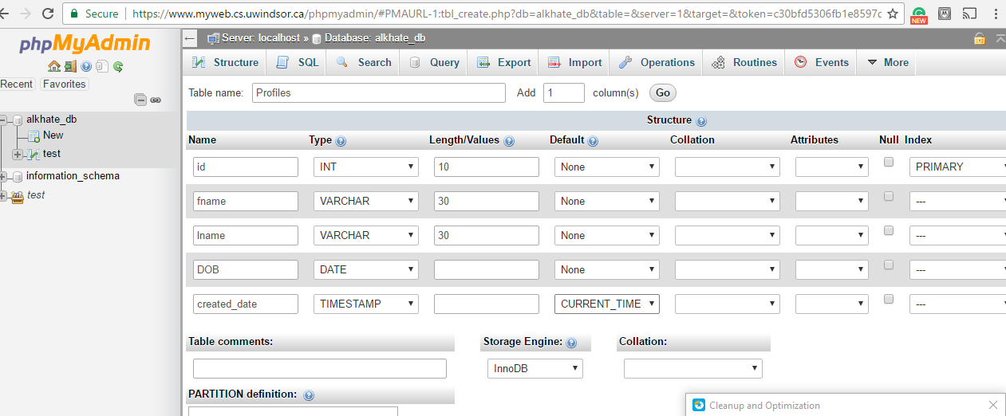
Create “Profiles” table

Slide 10
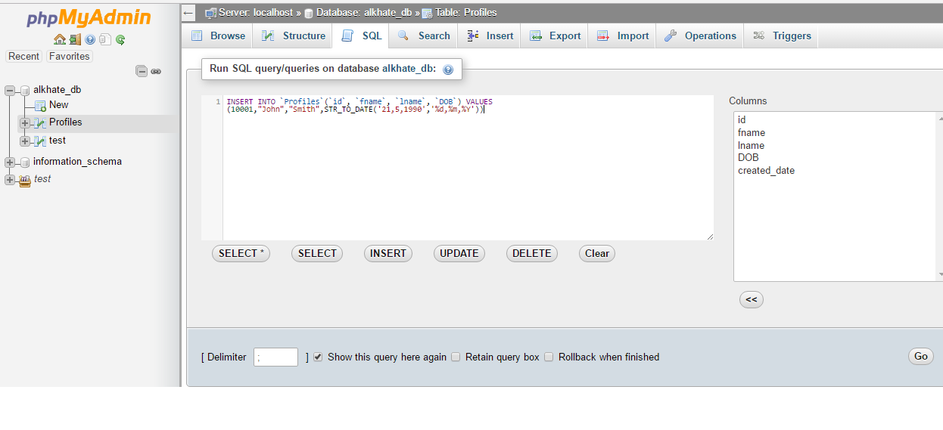
Insert a record in “Profiles” table
1- Type this sentence to insert a record
2-go

Slide 11
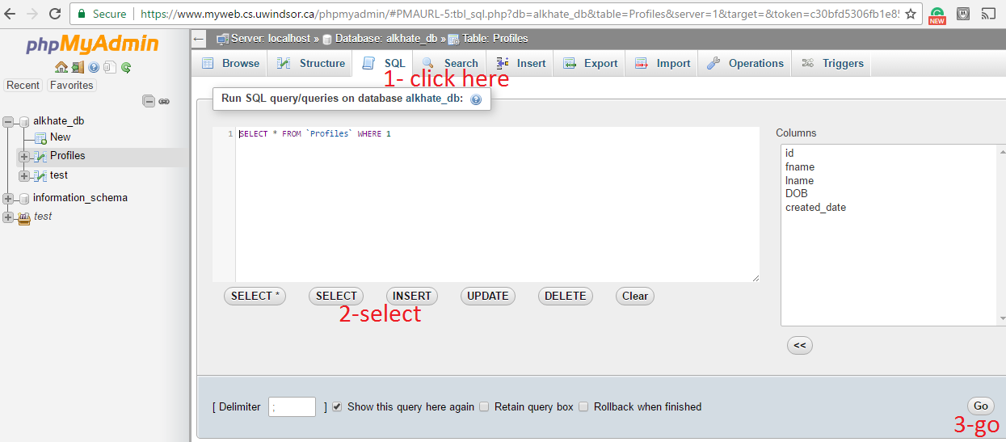
Query the records – find them

Slide 12
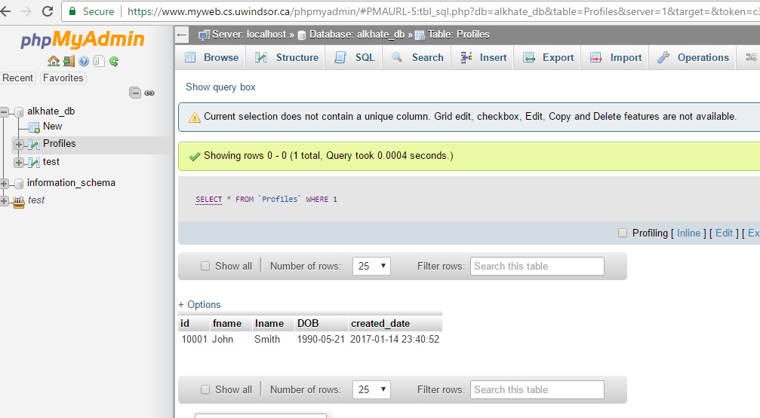
Query result

